Slide 1
Airbnb Toronto Data Analysis

Slide 2
Airbnb Toronto Data Analysis
Project Objectives
Look at the data picture of Airbnb market and try to see what’s going on.
Try to create prediction and advisory models for anyone looking at Airbnb
Data sources
Indideairbnb.com
Project Process Flow
Get, understand, and manipulate data
Analysis

Slide 3
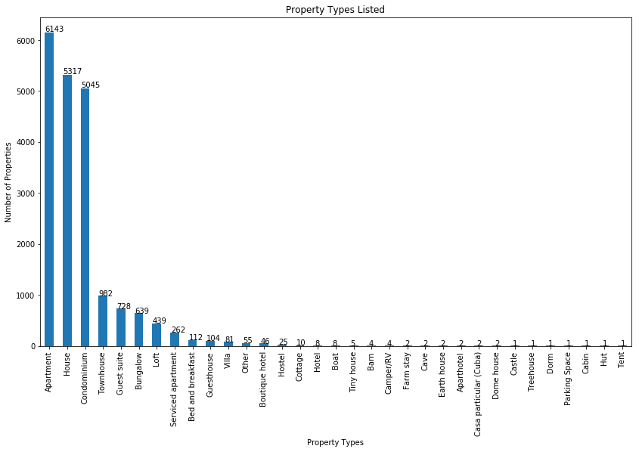
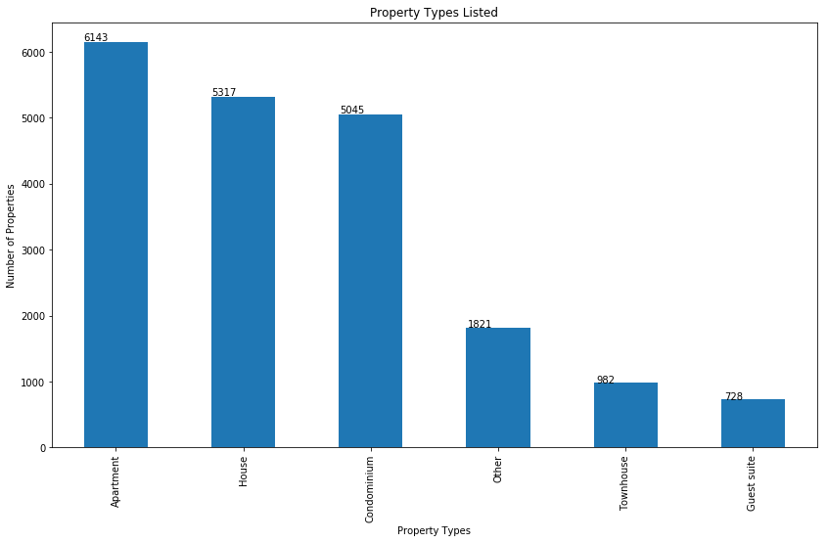
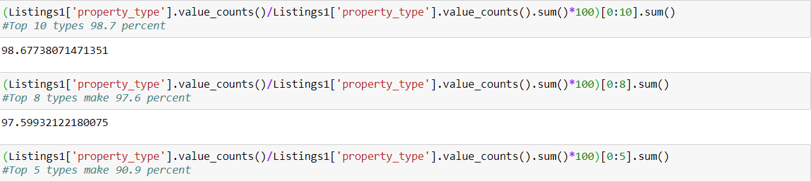
Airbnb Toronto Data Analysis Property types listed

Slide 4
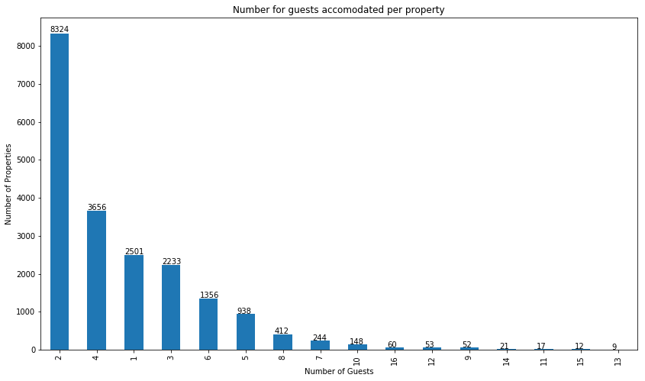
Airbnb Toronto Data Analysis Guests allowed per property

Slide 5
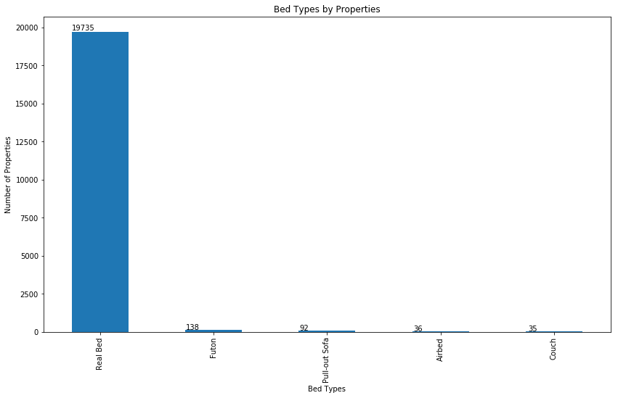
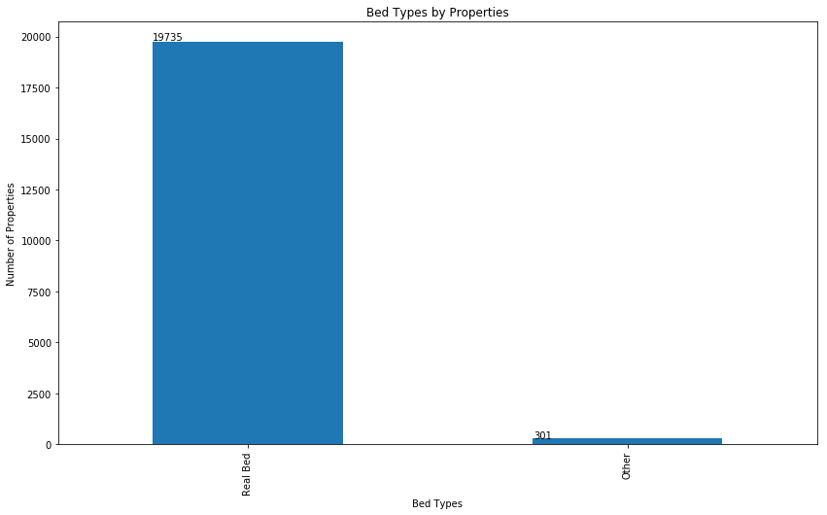
Airbnb Toronto Data Analysis Bed types listed

Slide 6
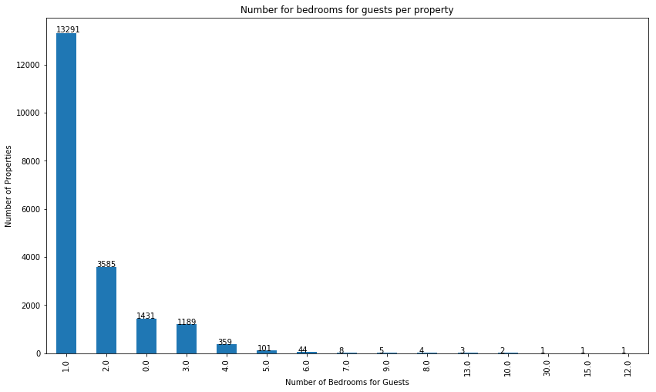
Airbnb Toronto Data Analysis Number of bedrooms

Slide 7
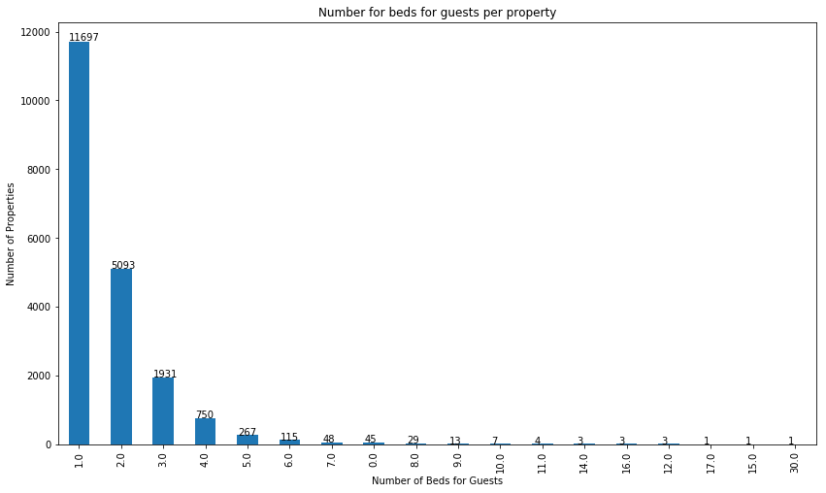
Airbnb Toronto Data Analysis Number of beds for guests per property

Slide 8
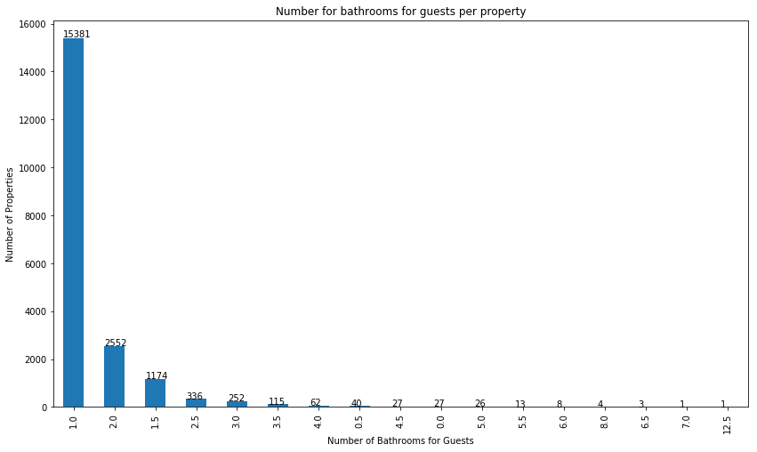
Airbnb Toronto Data Analysis Number of bathrooms for guests per property

Slide 9
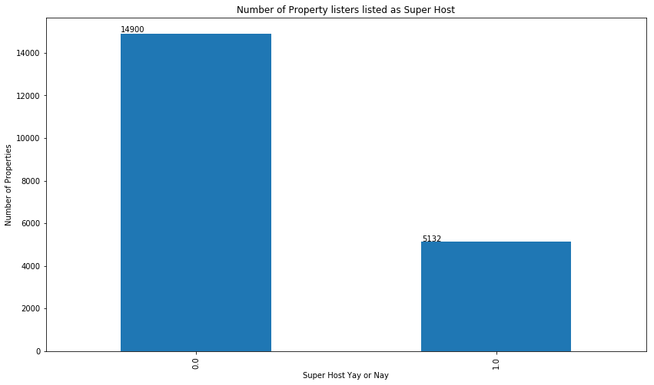
Airbnb Toronto Data Analysis Number of hosts listed as super hosts

Slide 10
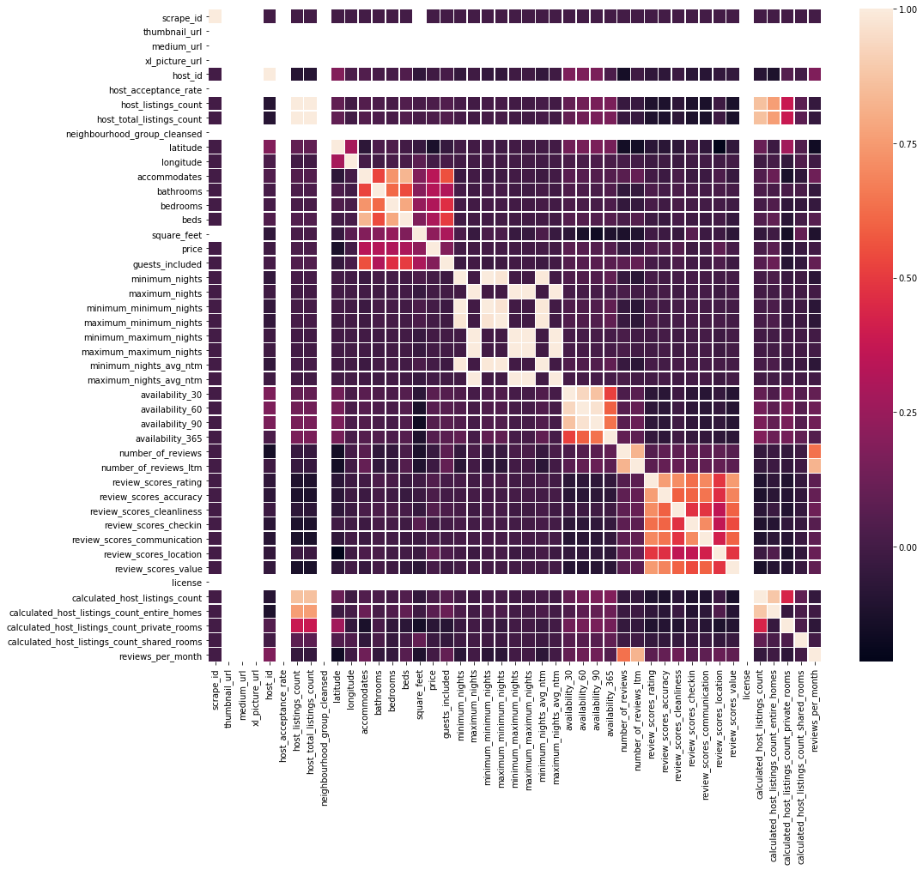
Airbnb Toronto Data Analysis Correlation Matrix – All Attributes

Slide 11
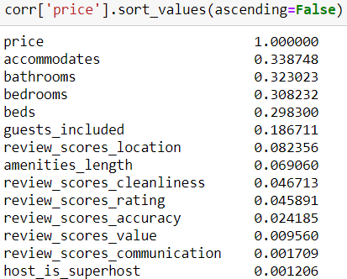
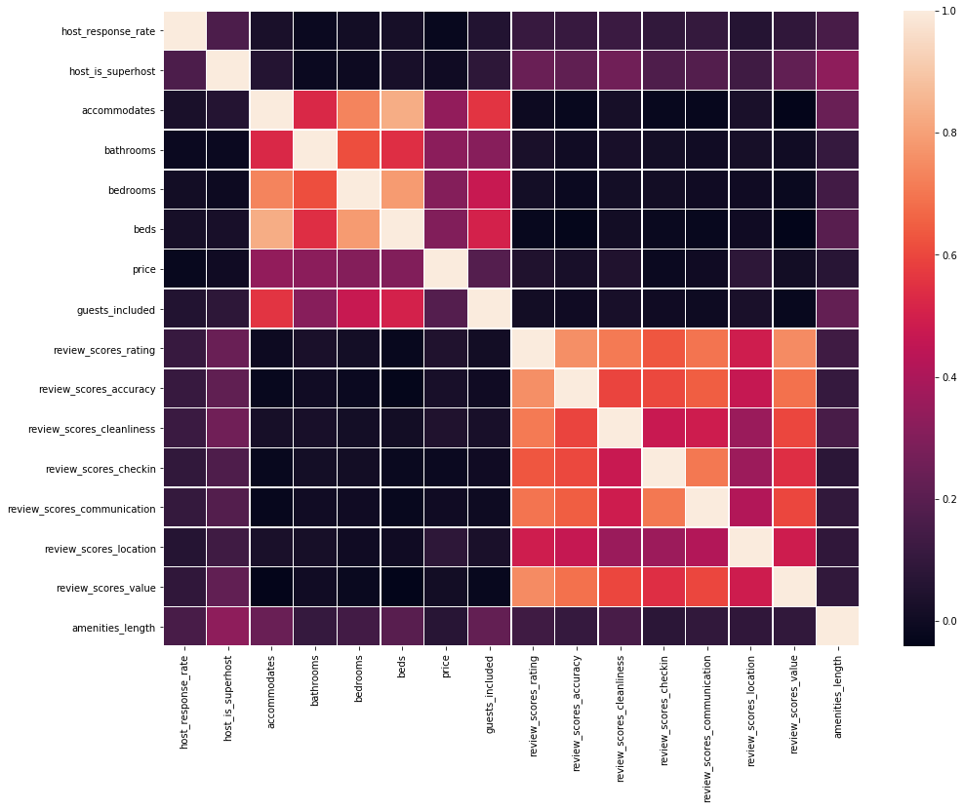
Airbnb Toronto Data Analysis Correlation Matrix – Selected Attributes

Slide 12
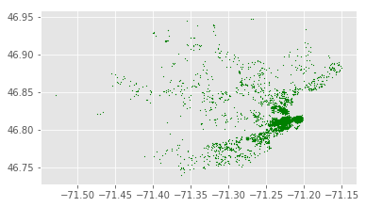
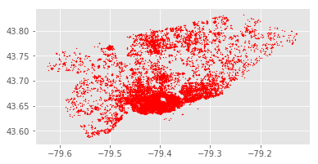
Airbnb Toronto Data Analysis Number of hosts listed as super hosts
Toronto
Quebec

Slide 13
Airbnb Toronto Data Analysis Scope for expansion – Few of the next possible steps
Help in deciding in which locations to invest for starting an Airbnb business
Sentiment Analysis using Natural Language Took Kit (NLTK) and TextBlob
Price Prediction
Finding out what makes a property successful, e.g. which amenities are most important, and what other factors decide success

Slide 14
Thank You

